Slide 1
UNGUIDED MEDIA

Slide 2
Unguided Media
Unguided media transport electromagnetic waves without using a physical conductor.
This type of communication is often referred to as wireless communication.
Signals are normally broadcast through free space and thus are available to anyone who has a device capable of receiving them. Unguided signals can travel from the source to destination in several ways: ground propagation, sky propagation, and line-of- sight propagation.

Slide 3
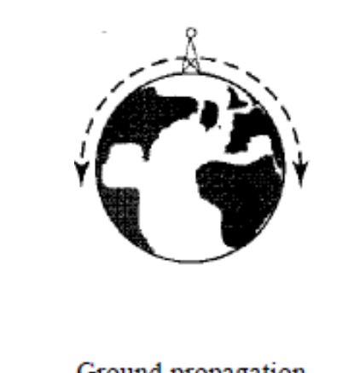
Ground Propagation
In ground propagation, radio waves travel through the lowest portion of the atmosphere,
These low frequency signals emanate in all directions from the transmitting antenna and follow the curvature of the planet.
Distance depends on the amount of power in the signal: The greater the power, the greater the distance.

Slide 4
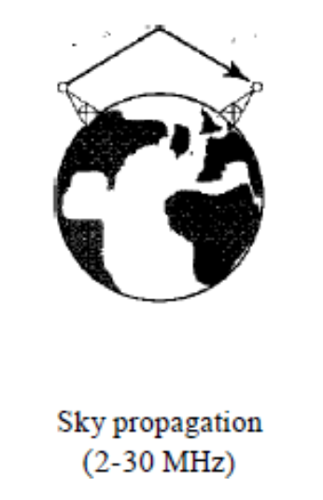
Sky Propagation
In sky propagation, higher-frequency radio waves radiate upward into the ionosphere where they are reflected back to earth.
This type of transmission allows for greater distances with lower output power.

Slide 5
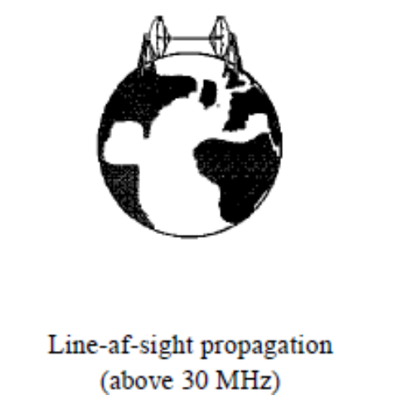
Line-or-sight
In line-or-sight propagation, very high-frequency signals are transmitted in straight lines directly from antenna to antenna. Antennas must be directional, facing each other, and either tall enough or close enough together not to be affected by the curvature of the earth. Line-of-sight propagation is tricky because radio transmissions cannot be completely focused.

Slide 6
Radio Waves
Waves ranging in frequencies between 3 kHz and 1 GHz are called radio waves.
Radio waves are omnidirectional. When an antenna transmits radio waves, they are propagated in all directions. This means that the sending and receiving antennas do not have to be aligned.
A sending antenna sends waves that can be received by any receiving antenna.
The omnidirectional property has a disadvantage, too. The radio waves transmitted by one antenna are susceptible to interference by another antenna that may send signals using the same frequency or band.

Slide 7
Radio waves, particularly those waves that propagate in the sky mode, can travel long distances. This makes radio waves a good candidate for long-distance broadcasting such as AM radio.
Radio waves, particularly those of low and medium frequencies, can penetrate walls. This characteristic can be both an advantage and a disadvantage. It is an advantage because, for example, an AM radio can receive signals inside a building. It is a disadvantage because we cannot isolate a communication to just inside or outside a building.
The radio wave band is relatively narrow, just under 1 GHz, compared to the microwave band. When this band is divided into sub bands, the sub bands are also narrow, leading to a low data rate for digital communications.

Slide 8
Microwaves
Electromagnetic waves having frequencies between 1 and 300 GHz are called microwaves.
Microwaves are unidirectional. When an antenna transmits microwave waves, they can be narrowly focused. This means that the sending and receiving antennas need to be aligned. The unidirectional property has an obvious advantage.
A pair of antennas can be aligned without interfering with another pair of aligned antennas.

Slide 9
The following describes some characteristics of microwave propagation:
a. Microwave propagation is line-of-sight. Since the towers with the mounted antennas need to be in direct sight of each other, towers that are far apart need to be very tall. The curvature of the earth as well as other blocking obstacles does not allow two short towers to communicate by using microwaves. Repeaters are often needed for long distance communication.

Slide 10
b. Very high-frequency microwaves cannot penetrate walls. This characteristic can be a disadvantage if receivers are inside buildings.
c. The microwave band is relatively wide, almost 299 GHz. Therefore wider sub bands can be assigned, and a high data rate is possible
d. Use of certain portions of the band requires permission from authorities. ​

Slide 11
Infrared
Infrared waves, with frequencies from 300 GHz to 400 THz (wavelengths from 1 mm to 770 nm), can be used for short-range communication.
Infrared waves, having high frequencies, cannot penetrate walls.
This advantageous characteristic prevents interference between one system and another; a short-range communication system in one room cannot be affected by another system in the next room.

Slide 12
When we use our infrared remote control, we do not interfere with the use of the remote by our neighbors.
However, this same characteristic makes infrared signals useless for long-range communication.
In addition, we cannot use infrared waves outside a building because the sun's rays contain infrared waves that can interfere with the communication.

